Slide 1

Positive Behavioral Interventions & Supports
This Photo by Unknown Author is licensed under CC BY-NC-SA

Slide 2
Objectives
Share-out: Where are your teams at
Common Pitfalls & Work Time

Slide 3
What is School-wide PBIS?
  A systems approach, establishing the social culture and behavioral supports needed for schools to be effective learning environments for all students.
  PBIS is not an add-on program, it is a framework. It does not get rid of programs that work, it enhances them.
Notes:
A little framing—What is PBIS—SW, touches everyone, a systems approach in place—NOT a program—rather a system or framework around how we will serve our students in the SEL
Mention our work with turn around schools and how varying the cultures are and let that frame our work—working from a culturally responsive lens
Asian, Latino, coming to our country and schools for the first time—how do we build this work for everyone so we can have the most effective learning environments

Slide 4
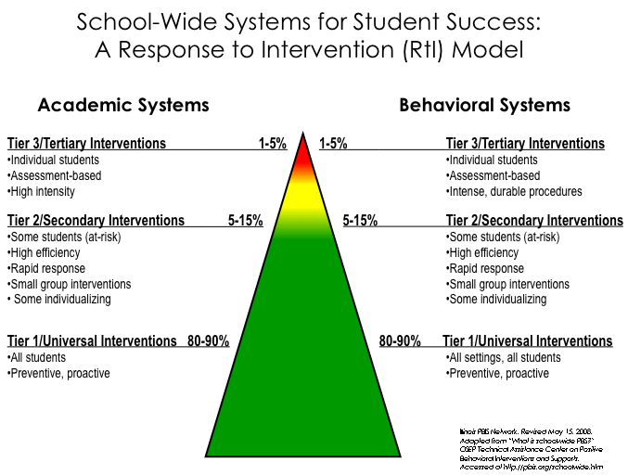
Notes:
4
Lets just refocus on what we are trying to do and using a three tiered framework. We want to get our Tier one response as large as possible. This day will be about assessing our fidelity and focusing on getting better outcomes. Everyone is going to be in different places but we all need to keep focused on tier 1.

Slide 5
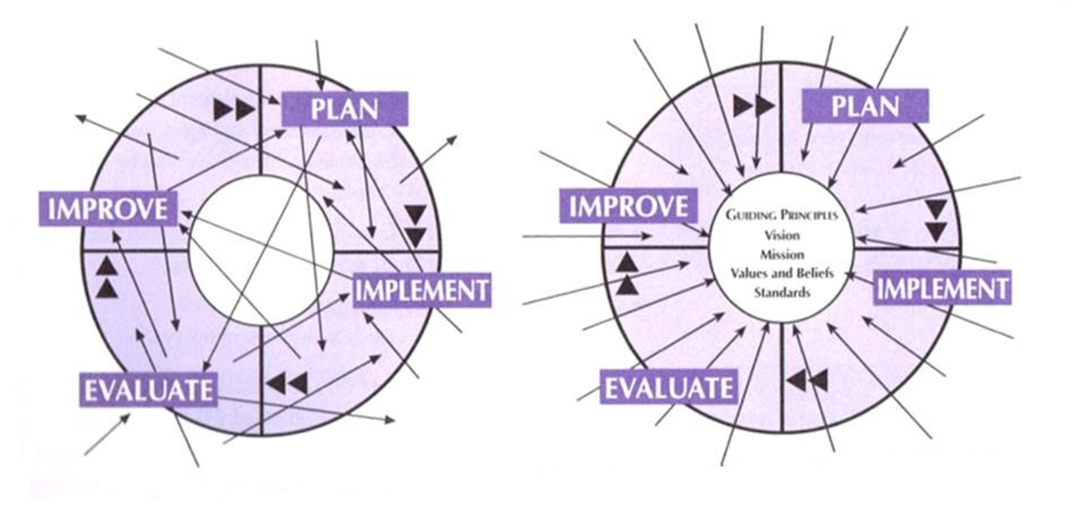
Random Acts of Improvement
Focused Acts of Improvement
From Data Analysis for Continuous School Improvement by Victoria Bernhardt
Notes:
If a school does not have a clear, shared vision, it has as many visions as it has people. Consequently, the most the school could ever hope for are random acts of improvement.

Slide 6
Why SWPBIS?
The fundamental purpose of SWPBIS is to make schools more effective learning environments for everyone.
Predictable
Positive
Safe
Consistent

Slide 7
SWPBS IMPLEMENTATION DRIVERS
Systems: To sustain
the implementation
Data: For decision making
Practices: Evidenced-based and doable
Outcomes
Notes:
Showing you this is on purpose. Everyone needs to know about the 4 drivers – your team and all your staff!

Slide 8

RtI=PBIS and PBIS=RtI
MTSS
Three Strands in Continuous School Improvement Plans
Culture of Collaboration
Response to Instruction
Family and Community Engagement

Slide 10
Top Ten Reasons PBIS Fails
    1. Lack of continuous administrative support & involvement
    2. Not tracking, reporting, & responding to data
    3. Lack of understanding that staff set and change culture in schools
    4. Lack of understanding commitment and buy-in from staff
    5. Lack of understanding that academic success is driven by school culture
    6. Not working through the PBIS processes as a team
    7. Taking on too much too fast (generally with positive intentions)
    8. Inconsistency of implementation by staff
    9. Looking for the negative vs. looking for positives in student behavior
    10. Focusing only on the high risk students
Notes:
What of these do you already know you are doing

Slide 11
Most Important Perceived Factors for Sustainability
School administrators actively support PBIS
School administrators describes PBIS as a top priority for the school
A school administrator regularly attends and participates in PBIS team meetings
The PBIS school team is well organized and operates efficiently
The school administrators ensure that the PBIS team has regularly scheduled time to meet
Notes:
Pick the 4 in order

Slide 12
Which features best predict sustained implementation?
Expected behaviors defined clearly
Problem behaviors defined clearly
Expected behaviors taught
Expected behaviors acknowledged regularly
Consistent consequences
CR procedures consistent with SW systems
Options exist for instruction
Instruction/materials match student ability
High rates of academic success
Access to assistance and coaching
Transitions are efficient

Slide 13
The Big Idea
It Ends Without Commitment
PBIS requires administrators, faculty, team members, and coaches to make a commitment to systems, practices, and data in order to effectively and efficiently implement and sustain SWPBIS within the context of an effective school community and district.
Notes:
Systems, Data and Practice

Slide 14

Tier 1 Leadership Team

Slide 15
Common Pitfall – Lack of Team and or Staff Buy In
Team is not representative
Team lacks admin support
Team does not use data for decision-making
Team does not meet at least monthly
Staff are not committed to PBIS
Some staff behavioral philosophies are not aligned with PBIS.

Slide 16
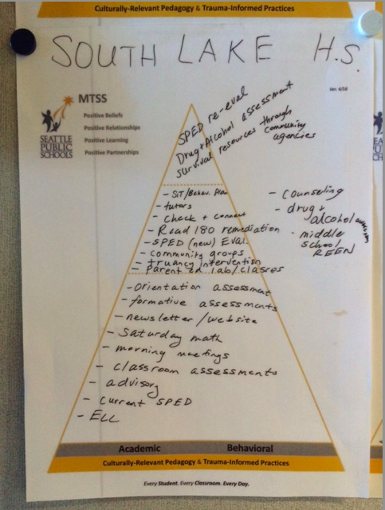

Slide 17
Discuss and Capture
15 Minutes
What do we need to be doing a better job of in regards to our team and staff buy-in?
Capture one action item on your action planning form.
What do you need to add to your triangle?

Slide 18
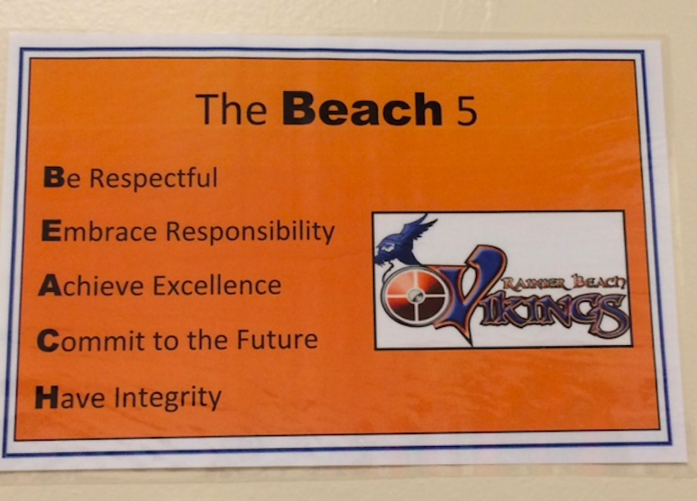
Establishing and Teaching Expectations

Slide 19
Common Pitfalls –
Establishing Expectations
Lack of Clear Definition & Understanding
“Values” Which Are Hard to Define (ie. Responsible, Respectful, Kind, Honest).
Lack Buy-In From ALL Stakeholders
Cultural Mismatch
Not Agreed Upon By All Staff

Slide 20
Schoolwide Social Expectations
Guidelines
Identify 3-5 Expectations That:
  Desired Behaviors that Replace Your Problem Behaviors
  Short, Positive Statements (what to do!)
  Easy to remember
  Consider the Culture of Community
For all students, staff, parents and others who come to the school
Notes:
20

Slide 21

Behavior Expectations
The school will focus on 3-5 behavioral expectations that are positively stated and easy to remember. In other words, rather than telling students what not to do, the school will focus on the preferred behaviors.
Panther Pledge:
  I am a…
  Panther who is
  RESPONSIBLE.
  I HELP the rest and
  Do my BEST
  Everyday!
Panther Chant:
We are Panthers, we are kind
We are respectful all the time
We are thoughtful and we care
We show excellence everywhere
Go Spiritridge!

Slide 22
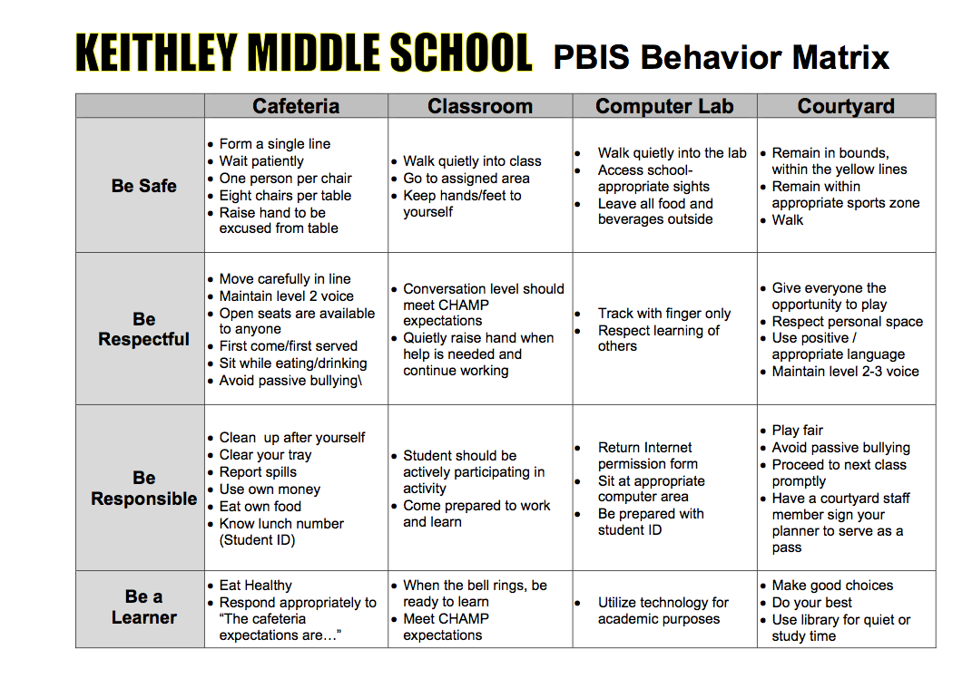

Slide 23


Slide 24
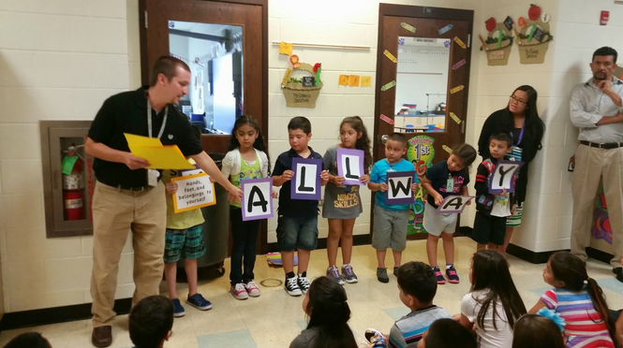
Teaching Expectations

Slide 25
Common Pitfalls – Teaching Expectations
No Clear System - Plan and Schedule
Lesson Plans Not Created
No Use of Pre-correction
Not Agreed Upon By All Staff
Data Not Being Used for Decision Making
Students Are Not Bought In

Slide 26
Discuss and Capture
15 Minutes
What do we need to be doing a better job of in regards to establishing and teaching expected behaviors?
Capture at least one action item on your action planning form.

Slide 27

Acknowledgement Systems

Slide 28
Common Pitfalls - Acknowledgement Systems
Lack of Understanding That All Behavior Gets Reinforced
Staff Lack Buy-In
Not Routine/Scheduled
Consequences Link to Reinforcement
Concerns about extrinsic reinforcement diminishes intrinsic motivation
Creation of a Cumbersome Program

Slide 29
Acknowledgement Systems:
Guidelines for Implementing
Encourage every staff member to reinforce positive student behavior and review often
Acknowledge frequently (5:1)
Ensure that earned = kept
Provide equal access to reinforcement for all students
Collect data on frequency of reinforcement
Notes:
29
Handouts and Activities:
Key Points not Included on the Slide:
More frequently at first…get it going. Then intermittently.
Only give reinforcement for desired behavior : make sure they know why they are getting it….otherwise, you might be reinforcing something else. You do not need to wait for perfection. Reinforce approximation towards behavior.
Students keep the reinforcer once they received it, because it represents the previously demonstrated desired behavior. If they do something wrong later, there should be separate consequences.
Equal access= don’t just focus on the “bad” kids or the “good” kids. All students should get to have a fresh start to earn reinforcement even if they have had challenges earlier in the day or week
Track how often people are reinforcing and how many reinforcers are being given. Use data to compare against office referral data. Should see that as reinforcement systems are increasing, office referrals are decreasing
Explanation of Terms or Ideas:
Video clip:
More guidelines:
More frequently at first…get it going.
Then intermittently.
Only give reward for behavior desire: make sure they know why they are getting it….otherwise, you might be rewarding something else
Refrain from having students losing rewards…if you earn it, keep it.
Equal access= don’t just focus on the “bad” kids or the “good” kids. All students should get to have a fresh start to earn reinforcement even if they have had challenges earlier in the day or week
How can they earn reward throughout entire day??
Collect data=track how often people are rewarding and how many reinforcers are being given. This data can be important to compare against office referral data. Should see that as reinforcement systems are increasing, office referrals are decreasing
How to reward staff for rewarding…it’s a shift that is often difficult to make. Staff must be rewarded for making that shift.

Slide 30
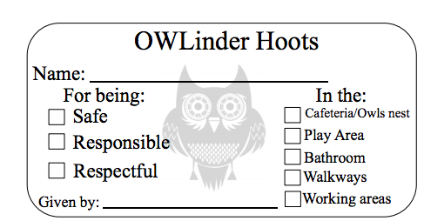
Caught Meeting Expectations Tickets

Slide 31
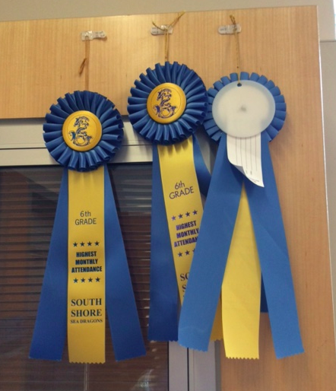
South Shore
Attendance Awards

Slide 32
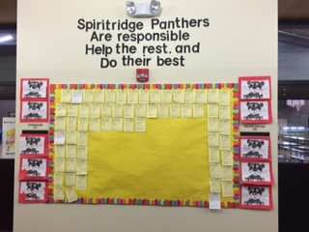
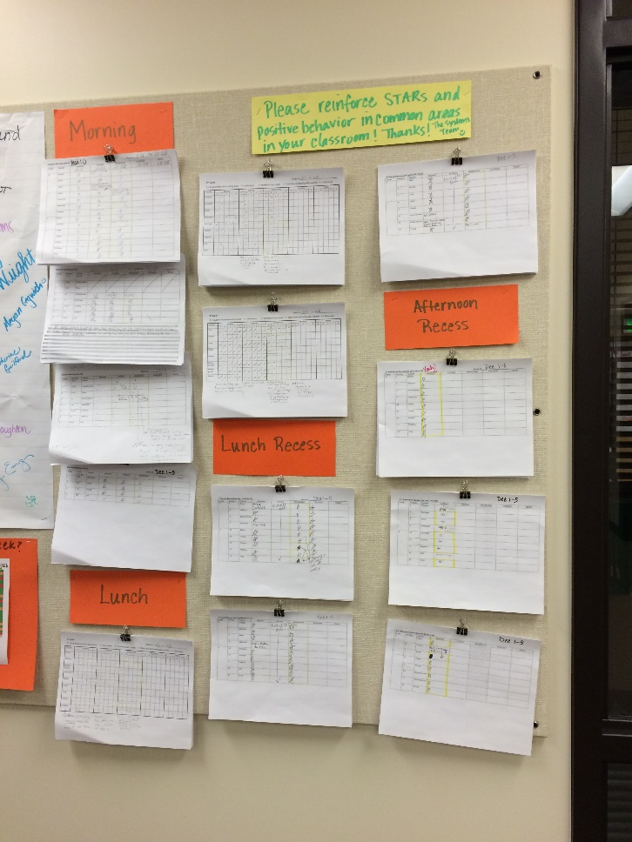


”Gotcha” Programs
STARS!
Panther Puzzles
Spirit the Panther!
Panther Pride Slips

Slide 33
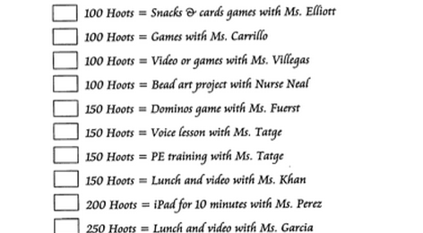

Slide 34
Avoid the trap of rewarding problem behavior
Negative reinforcement is alive and well.
  Escaping something unpleasant is a reward.
Unpleasant
Events
Escape from
Unpleasant
Events
Problem
Behavior
Reprimand/Failure Skip School Yes

Slide 35
Discuss and Capture
15 Minutes
What do we need to be doing a better job of in regards to providing feedback and building relationships.
Capture at least one action item on your action planning form.

Slide 36
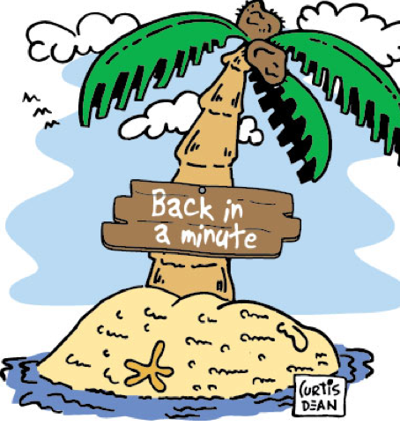
15 Minute Break

Slide 37

Procedures for Dealing With Behavioral Errors

Slide 38
Common Pitfalls
Problem Behaviors Not Defined
Lack of Agreement/Consistency on Handling Behaviors
Staff Lack Skills to Address Behaviors
Referral Form Lack Needed Information
Behavioral Data Not Being Analyzed

Slide 39
Clear, Consistent, Logical Procedures for Responding to Behavioral Errors
Conferencing
Problem Solving
Re-teaching
Restorative Approaches – Student Driven
Natural Consequences

Slide 40
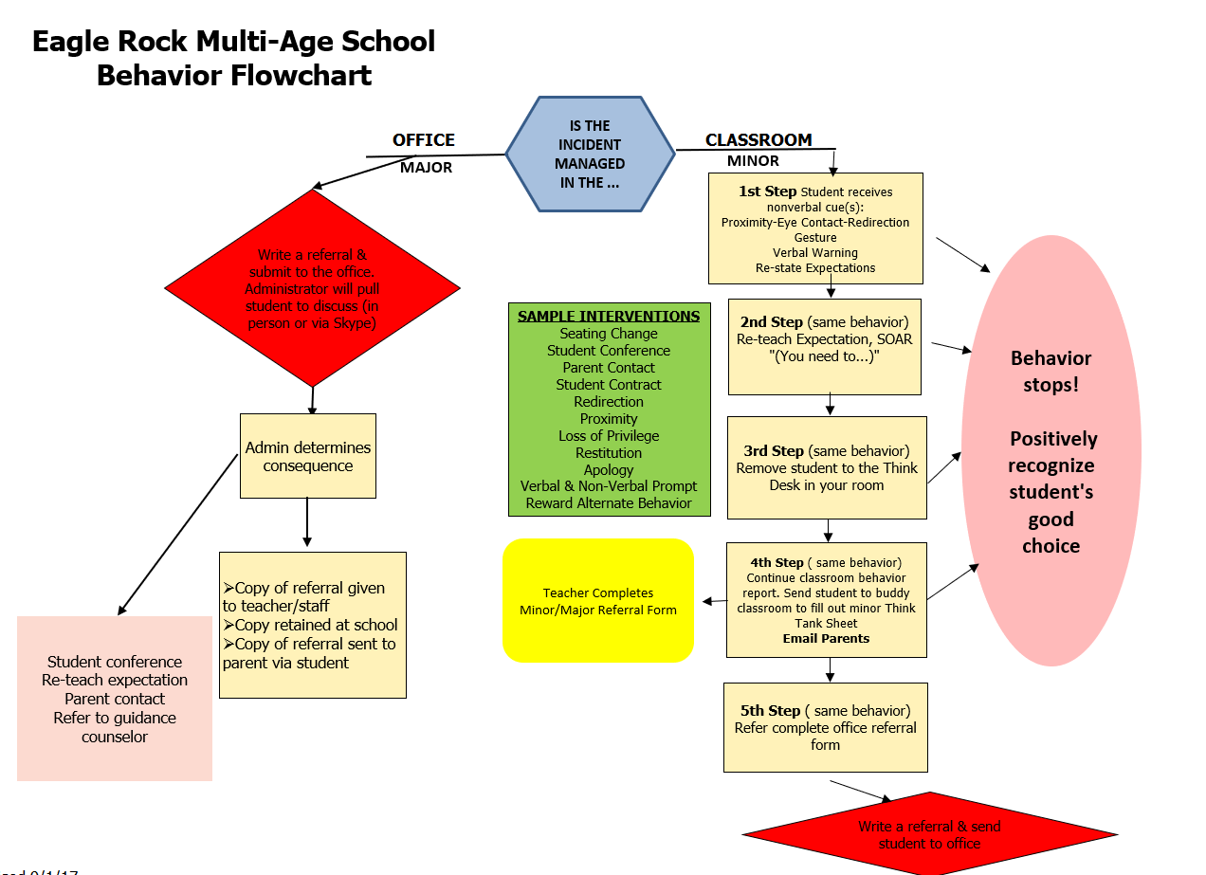

Slide 41
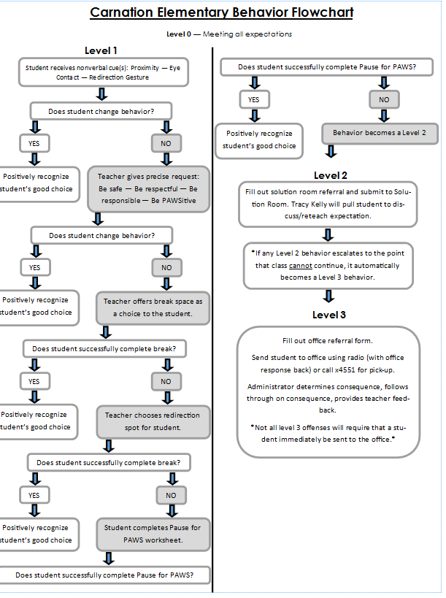

Slide 42
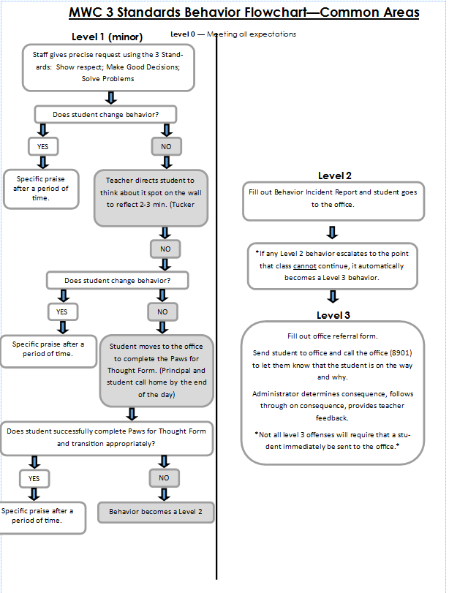

Slide 43
Discuss and Capture
15 Minutes
What do we need to be doing a better job of in regards to responding to behaviors?
Capture at least one action item on your action planning form.

Slide 44

Data-Based Decision Making

Slide 45
Using Outcomes Data for
Problem-Solving
Use data to identify a possible problem
Use data to build a precise “problem statement”
Use data to select a solution (intervention)
Use data to assess if a solution is
(a) being implemented
(b) effective

Slide 46
Problem Solving
101
Identify Problem
with
Precision
Identifying Problems has two parts:
  Identification of a primary statement/problem
    Indicates a difference between what is happening and what is desired
    Need to know what to expect as typical
    Use benchmark, aim line, median score, etc.
  b. Identify the problem with precision
    Indicates a difference between what is happening and what is desired as precision elements are defined
    Need to know precision elements including what, where, when, who, why and how often (frequency or rate) the problem occurs

Slide 47
Building Problem Statements
Primary Statements:
    Indicate a discrepancy between what we have and what we want.
Precise Problem Statements:
  Indicate the problem with sufficient precision to allow problem solving
    What is happening (and how does it differ from what we want)
    How often is it happening
    When is it happening
    Where is it happening
    Who is involved
    Why does it keep happening

Slide 48
Primary versus Precision Statements
Primary Statements
  Too many referrals
  September has more suspensions than last year
  Gang behavior is increasing
  The cafeteria is out of control
  Student disrespect is out of control
Precision Statements
  There are more ODRs for aggression on the playground than last year. These are most likely to occur during first recess, with a large number of students, and the aggression is related to getting access to the new playground equipment.

Slide 49
Data needed to move from a Primary to a Precise statement?
What problem behaviors are most common?
  ODR per Problem Behavior
Where are problem behaviors most likely?
  ODR per Location
When are problem behaviors most likely?
  ODR per time of day
Who is engaged in problem behavior?
  ODR per student
Why are problem behaviors sustaining?
  Custom reports and graphs
Newton, J. S., Todd, A. W., Algozzine, K., Horner, R. H., & Algozzine, B. Version 2 (2012). The Team Initiated Problem Solving (TIPS) Training Manual. Eugene, OR: University of Oregon, Educational and Community Supports. Unpublished training manual.

Slide 50
Solution Action Elements | Possible Generic Solution Actions
Prevent What can we do to prevent the problem? | Adjust physical environment. Define & document expectations and routines. Assure consistent & clear communication with all staff.
Teach What do we need to teach to solve the problem? | Explicit instruction linked to school wide expectations. Teach what to do, how to do it and when to do it. Model respect .
Reward What can we do to reward appropriate behavior? | Strengthen existing school wide rewards. Include student preferences. Use function-based reinforcers
Extinguish What can we do to prevent the problem behavior from being rewarded? | Use ‘signal’ for asking person to ‘stop’. Teach others to ignore (turn away/look down) problem behavior.
Correct What will we do to provide corrective feedback? | Intervene early by using a neutral, respectful tone of voice. Label inappropriate behavior followed by what to do Follow SW discipline procedures
Safety Do we need additional safety precautions? | Separate student from others if he/she is unable to demonstrate self-control. Make sure adult supervision is available.

Slide 51
The Problem-Solving “Mantra”
Do we have a problem?
What is the precise nature of our problem?
Why does the problem exist, & what can we do about it?
What are the actual elements of our plan?
Is our plan being implemented, & is it working?
What is the goal?
Newton, J.S., Todd, A.W., Algozzine, K, Horner, R.H. & Algozzine, B. (2009). The Team Initiated Problem Solving (TIPS) Training Manual. Educational and Community Supports, University of Oregon unpublished training manual.
Notes:
We want to use data to get to problem solving – not problem admiration! It is about getting to a plan we can implement. You have to set up the monitoring plan. This is the job of the facilitator.

Slide 52
Primary to
Precision Statements
15 Minutes
Can you build a primary statement about one thing that is happening at your school?
Complete the top portion of the TIPS Worksheet.

Slide 53
Team Time
What final questions do you have for me?
Action Plan for today?
From now until June?
For start of the school year in August?

